Slide 1
Build your first app
Android Developer Fundamentals V2
Lesson 1

Slide 2
1.1 Your first Android app

Slide 3
Contents
Android Studio
Creating "Hello World" app in Android Studio
Basic app development workflow with Android Studio
Running apps on virtual and physical devices

Slide 4
Prerequisites
Java Programming Language
Object-oriented programming
XML - properties / attributes
Using an IDE for development and debugging

Slide 5
Android Studio

Slide 6
What is Android Studio?
Android integrated development environment (IDE)
Project and Activity templates
Layout editor
Testing tools
Gradle-based build
Log console and debugger
Emulators

Slide 7
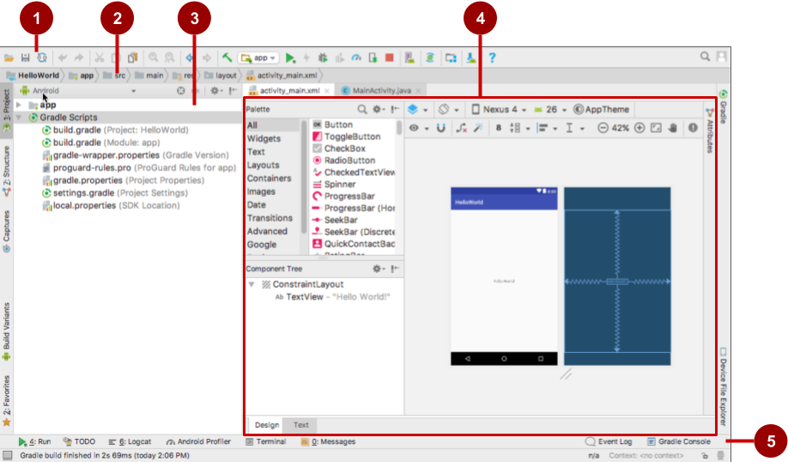
Android Studio interface
Toolbar
Navigation bar
Project pane
Editor
Tabs for other panes

Slide 8
Installation Overview
Mac, Windows, or Linux
Download and install Android Studio from https://developer.android.com/studio/
See 1.1 P: Android Studio and Hello World

Slide 9
Creating your first Android app

Slide 10
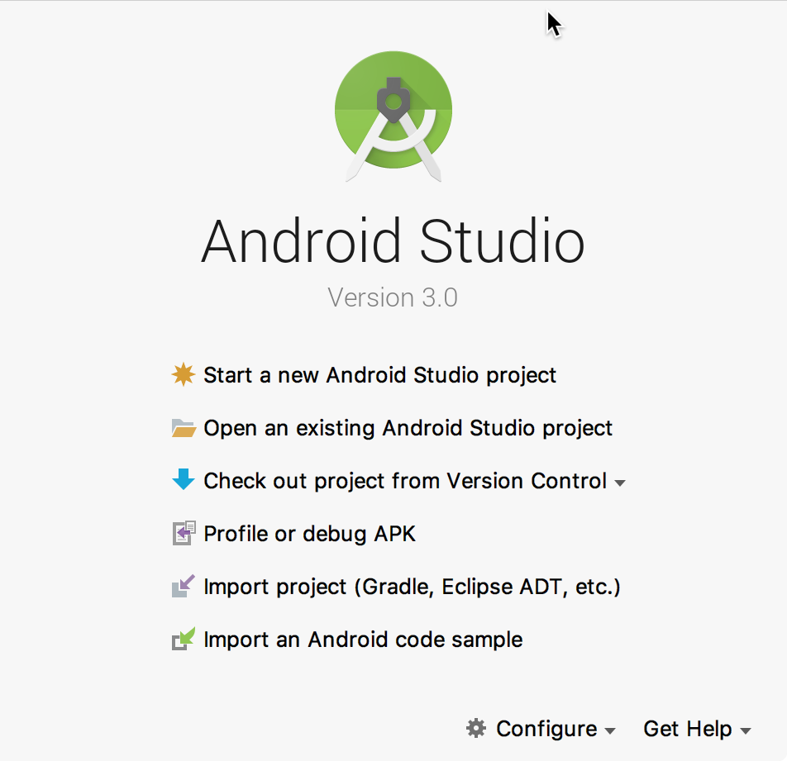

Start Android Studio

Slide 11
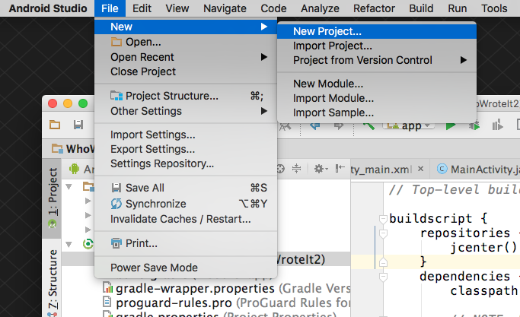
Create a project inside Android Studio

Slide 12
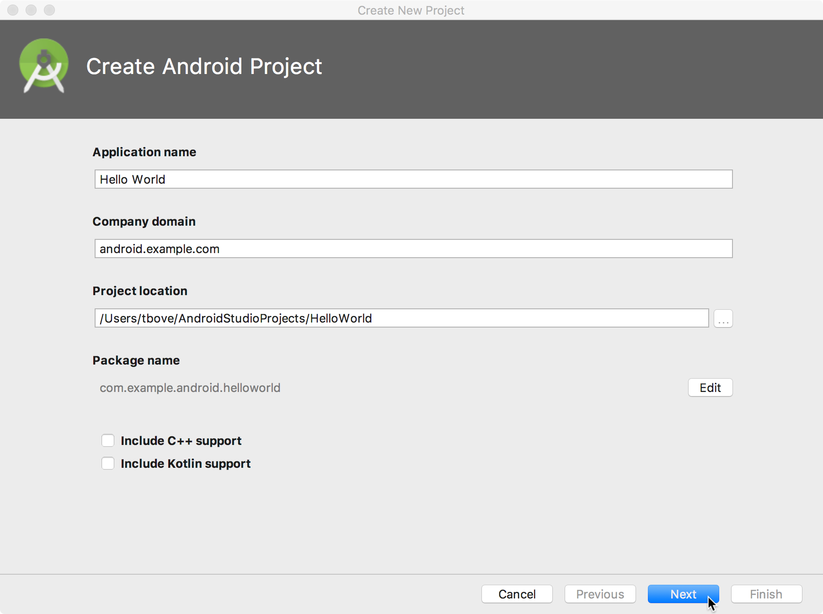
Name your app

Slide 13
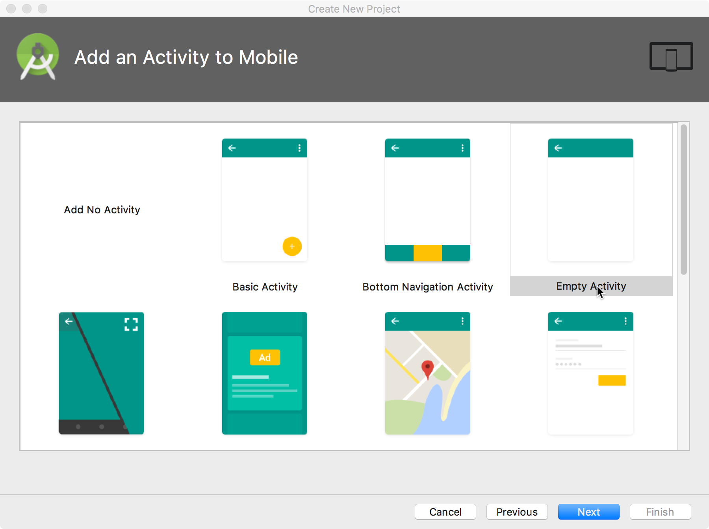
Pick activity template
Choose templates for common activities, such as maps or navigation drawers.
Pick Empty Activity or Basic Activity for simple and custom activities.

Slide 14
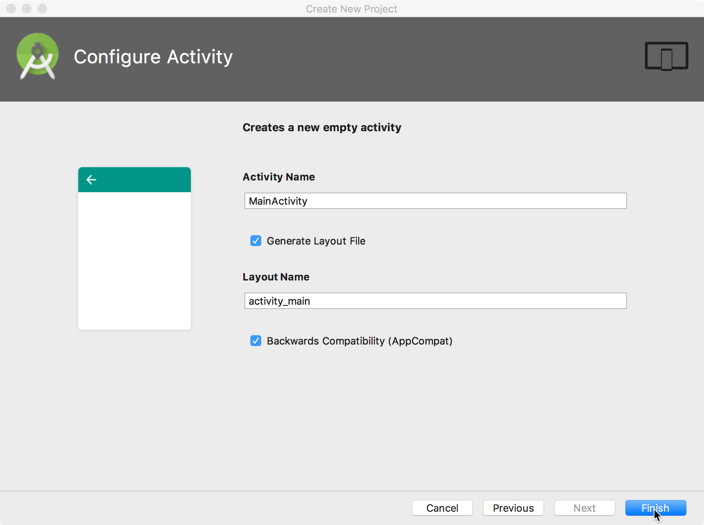
Name your activity
Good practice:
Name main activity MainActivity
Name layout activity_main
Use AppCompat
Generating layout file is convenient

Slide 15
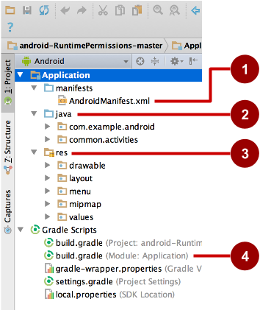
Project folders
manifests—Android Manifest file - description of app read by the Android runtime
java—Java source code packages
res—Resources (XML) - layout, strings, images, dimensions, colors...
build.gradle—Gradle build files

Slide 16
Gradle build system
Modern build subsystem in Android Studio
Three build.gradle:
project
module
settings
Typically not necessary to know low-level Gradle details
Learn more about gradle at https://gradle.org/

Slide 17
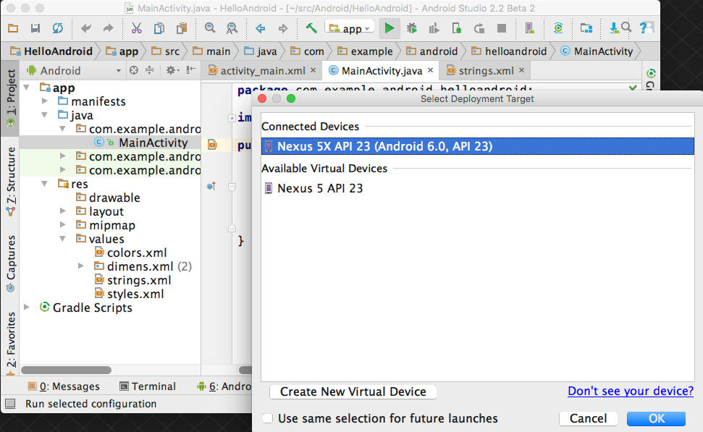
Run your app
Run
2. Select virtual or physical device
3. OK

Slide 18
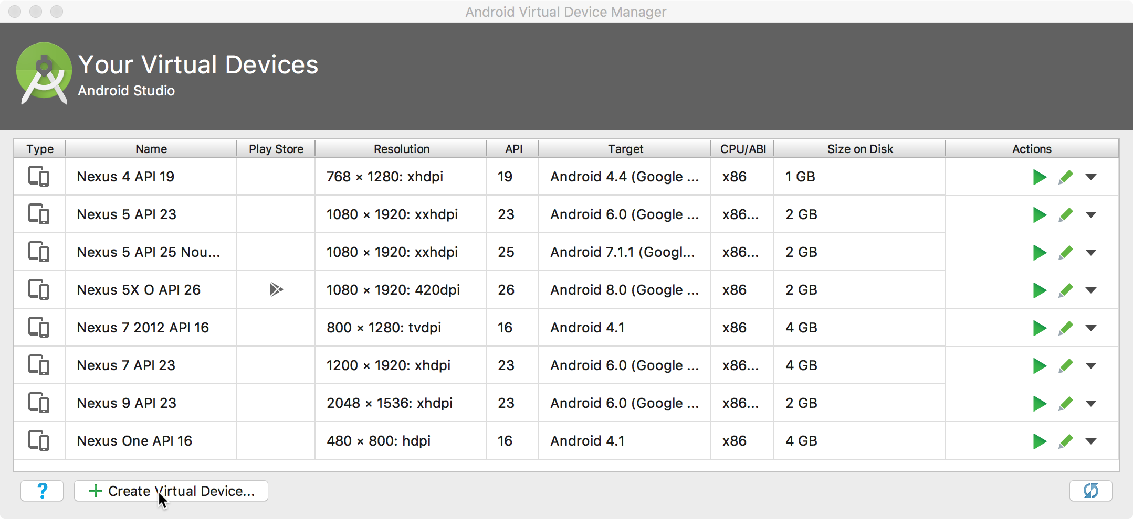
Create a virtual device
Use emulators to test app on different versions of Android and form factors.
Tools > Android > AVD Manager or:

Slide 19
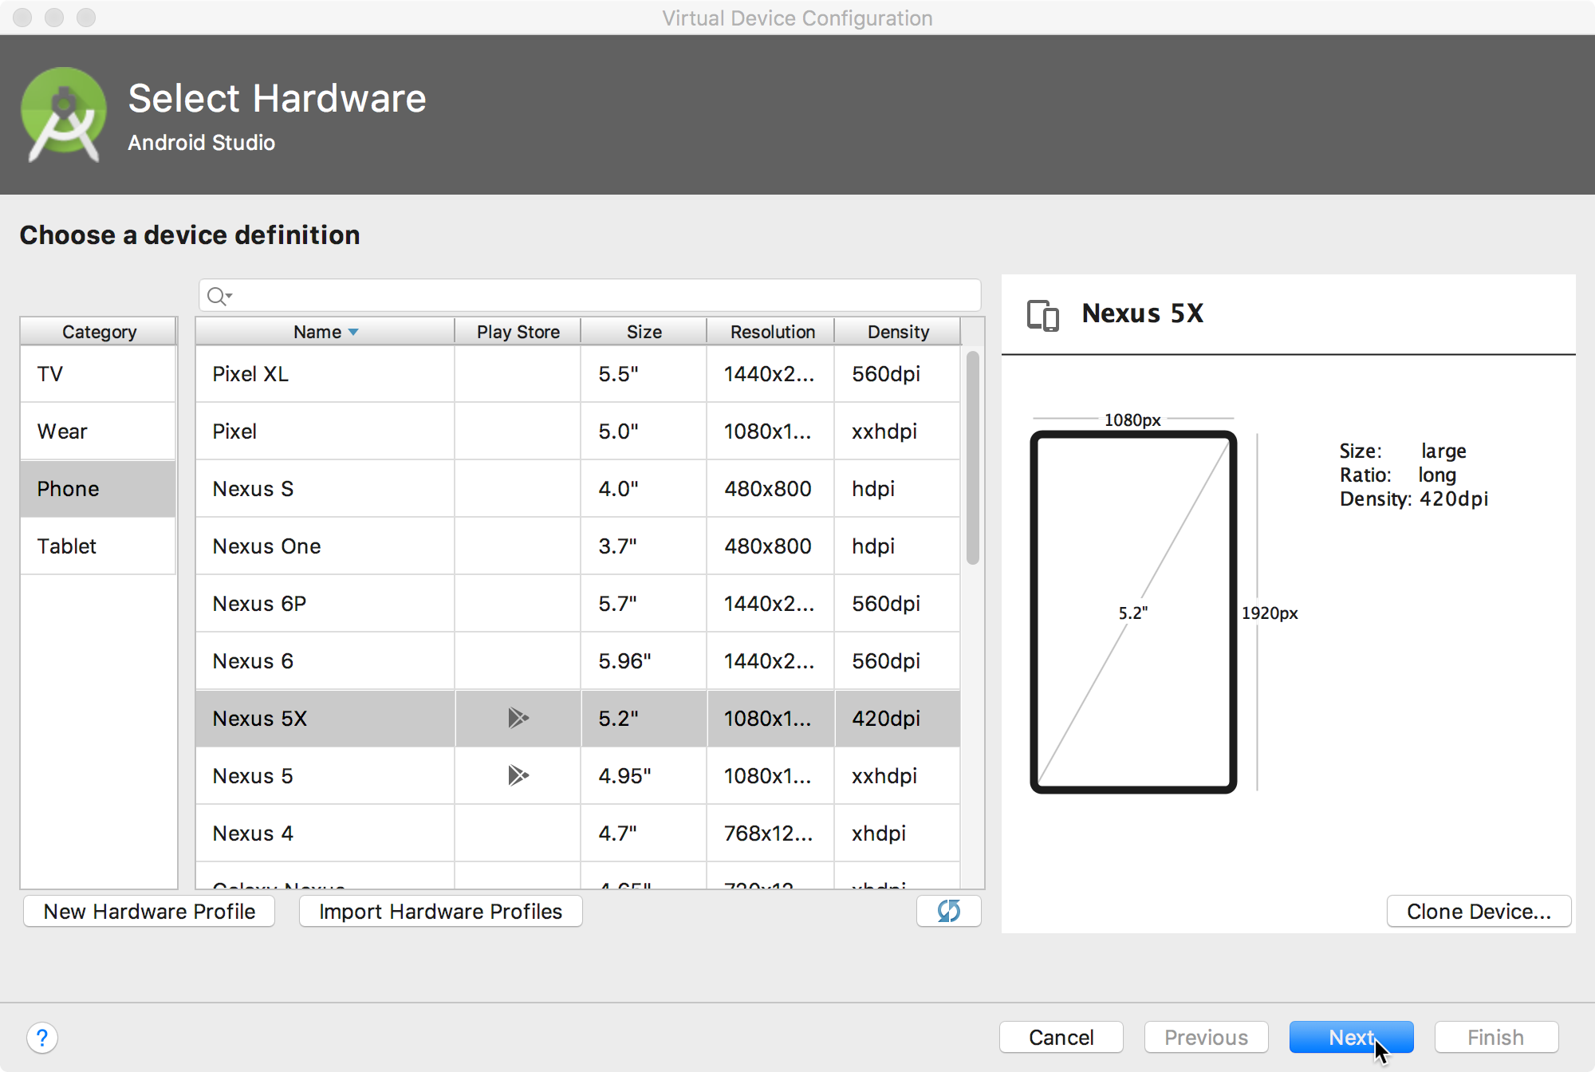
Configure virtual device
Choose hardware
Select Android version
Finalize

Slide 20
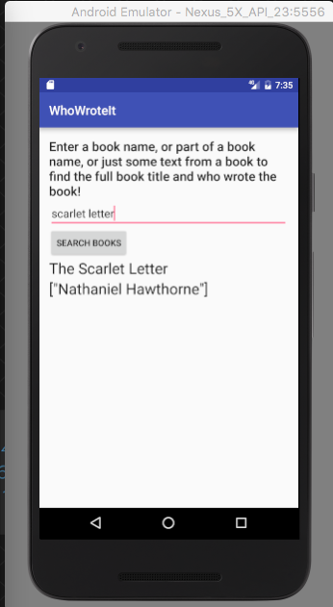

Run on a virtual device

Slide 21
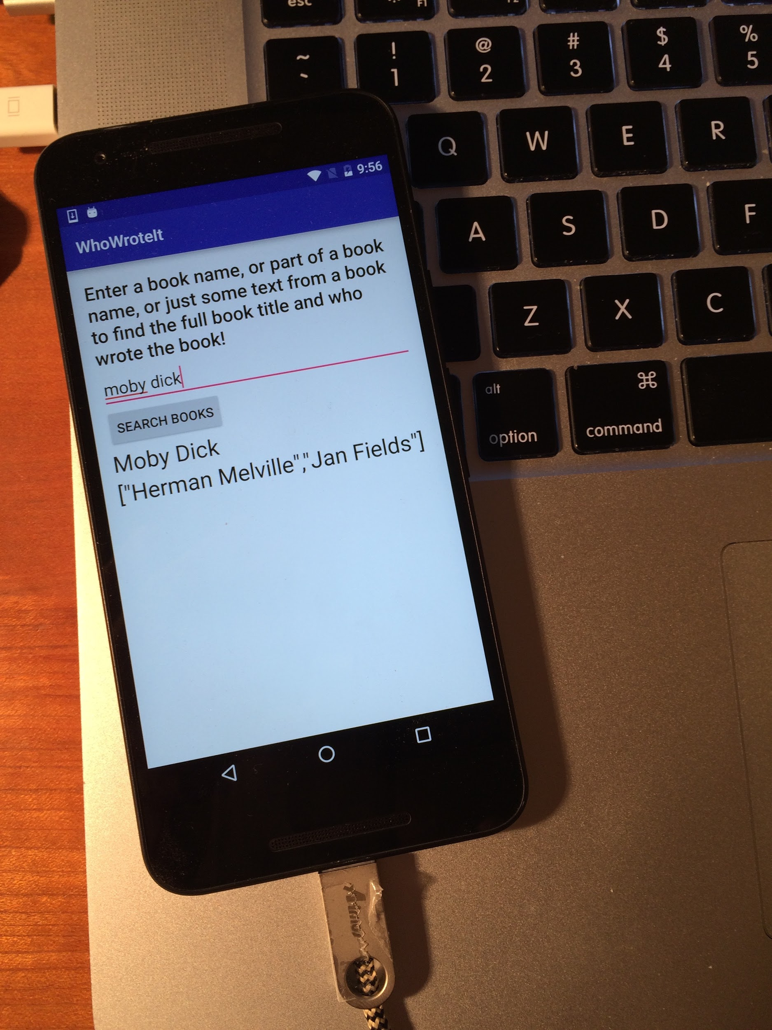
Run on a physical device
Turn on Developer Options:
Settings > About phone
Tap Build number seven times
Turn on USB Debugging
Settings > Developer Options > USB Debugging
Connect phone to computer with cable
Windows/Linux additional setup:
Using Hardware Devices
Windows drivers:
OEM USB Drivers

Slide 22
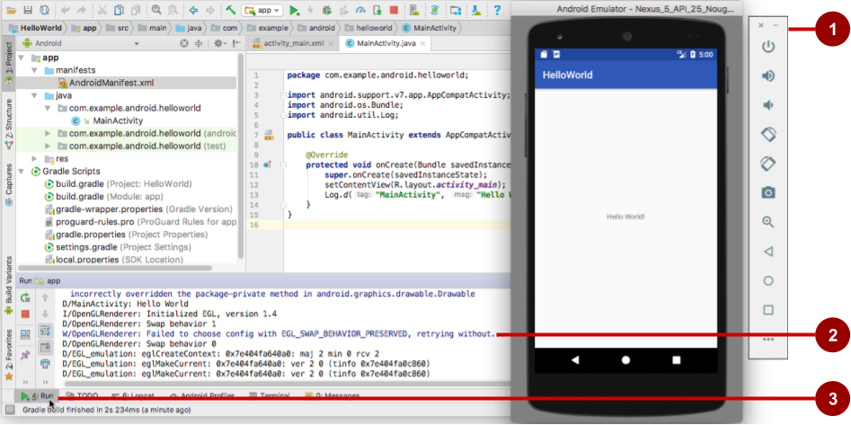
Get feedback as your app runs
Emulator running the app
Run pane
Run tab to open or close the Run pane

Slide 23
Adding logging to your app
As the app runs, the Logcat pane shows information
Add logging statements to your app that will show up in the Logcat pane
Set filters in Logcat pane to see what's important to you
Search using tags

Slide 24
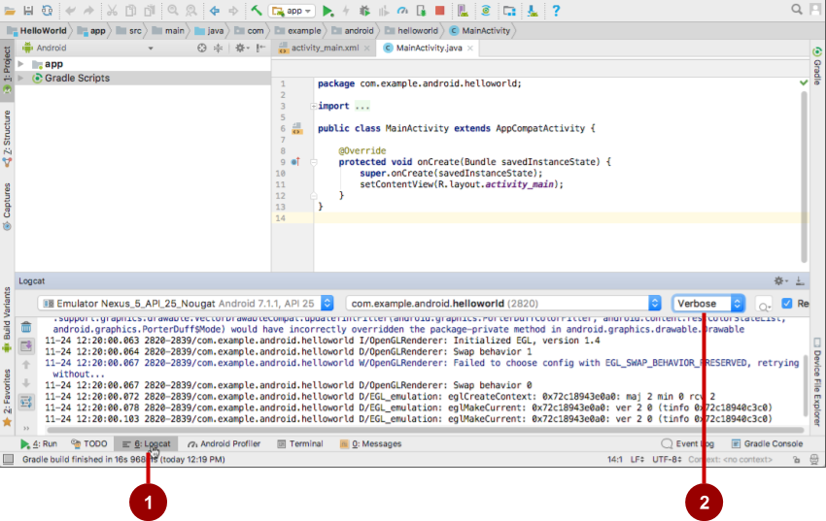
The Logcat pane
Logcat tab to show Logcat pane
Log level menu

Slide 25
Logging statement
import android.util.Log;
// Use class name as tag
private static final String TAG = MainActivity.class.getSimpleName();
// Show message in Android Monitor, logcat pane
// Log.<log-level>(TAG, "Message");
Log.d(TAG, “Creating the URI…”);

Slide 26
Learn more
Meet Android Studio
Official Android documentation at developer.android.com
Create and Manage Virtual Devices
Supporting Different Platform Versions
Supporting Multiple Screens

Slide 27
Learn even more
Gradle Wikipedia page
Google Java Programming Language style guide
Find answers at Stackoverflow.com

Slide 28
What's Next?
Concept Chapter: 1.1 Your first Android app
Practical: 1.1 Android Studio and Hello World

Slide 29
END

Slide 30
CODELABS

Slide 31
Task 1: Install Android Studio
https://developer.android.com/studio/install.html

Slide 32
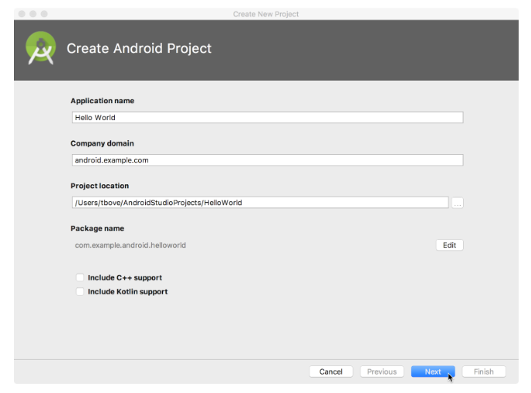
Task 2: Create the Hello World app

Slide 33
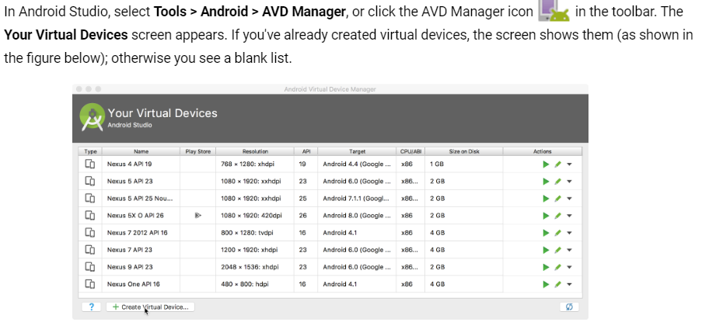
Task 3: Use a virtual device

Slide 34
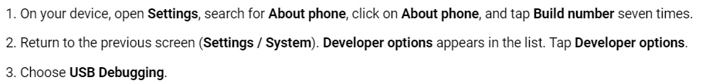
Task 4: Use a physical device

Slide 35
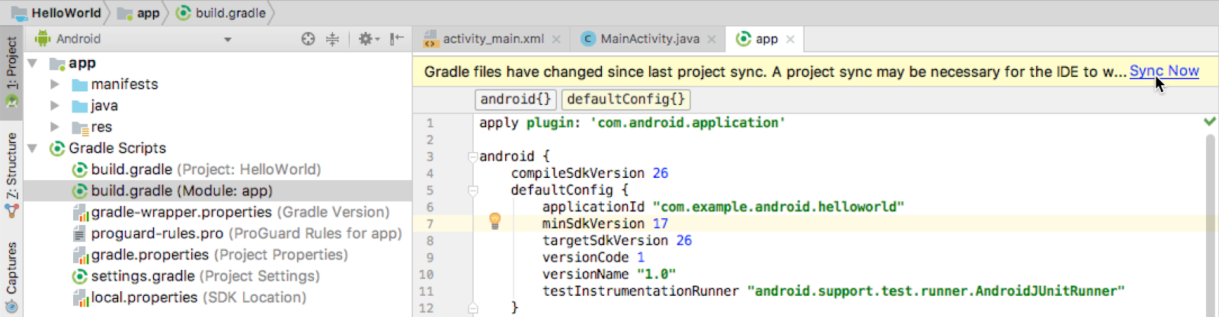
Task 5: Change app’s gradle

Slide 36

Task 6: Add log statement

